Slide 1

Rationale
Introduction to Windows Store App Development Using HTML5 and JavaScript
Computer science is a field of study that deals with solving a variety of problems by using computers.
  To solve a given problem by using computers, you need to design an algorithm for it.
Multiple algorithms can be designed to solve a particular problem.
An algorithm that provides the maximum efficiency should be used for solving the problem.
  The efficiency of an algorithm can be improved by using an appropriate data structure.
Data structures help in creating programs that are simple, reusable, and easy to maintain.
This module will enable a learner to select and implement an appropriate data structure and algorithm to solve a given programming problem.

Slide 2
Objectives
  In this session, you will learn to:
  Use animations
Notes:
2

Slide 3
Using Animations
  Windows 8 is designed for effective touch interaction and provides instant visual feedback for user actions by using purposeful animations.
  These transitions and animations enhance the UI of the app and make it more attractive.
  It draws the attention of the user to the changes occurring in the app.
Notes:
3

Slide 4
Exploring the Animation Library
  Animation library:
  Includes a set of predefined animations that can be added in your app.
  Contains animations that help:
    Implementing animations in your app based on the guidelines of Windows Store apps.
    Implementing fast and fluid transitions between various UI states without distracting the users.
Notes:
4

Slide 5
Exploring the Animation Library (Contd.)
  Animation Library provides the following animations that can be used in an app:
Page transition | Show/Hide panel
Content transition | Add/Delete from list
Fade in/out | Add/Delete from search list
Crossfade | Peek
Pointer up/down | Badge update
Expand/Collapse | Start/End a drag or drag-between
Reposition | Swipe hint
Show/Hide popup | Swipe select/deselect
Show/Hide edge
Notes:
5

Slide 6


Just a Minute
  Which one of the following animations is used to animatedly update the content of a tile to display an image and text alternatively?
    1. Peek
    2. Badge update
    3. Swipe hint
    4. Crossfade

Slide 7
Just a Minute (Contd.)
  Solution:
    1. Peek

Slide 8
Adding Animations
  To add an animation:
  Select the required type of animation from a predefined set of animations.
  Add the selected animation in your app.
  Example:
  A content transition can be implemented by using the WinJS.UI.Animation.enterContent() function.
  The following code snippet applies the enterContent transition to the heading in an app:
      var content = document.getElementById("heading2");
      WinJS.UI.Animation.enterContent(content, { left: "100px", top: "100px" });

Slide 9
Adding Animations (Contd.)
  A reposition animation can be implemented by using the WinJS.UI.Animation.createRepositionAnimation() function.
Let us look at an example, which adds animations in an app

Slide 10
Adding Animations (Contd.)
  Apart from using the animations from Animation Library, you can use the WinJS.UI.executeAnimation() function to add animations to your app.
  The syntax of the WinJS.UI.executeAnimation() function is:
    WinJS.UI.executeAnimation(element, animation).done( /* Your success and error handlers */ );

Slide 11
Adding Animations (Contd.)
  Example:
  The following code snippet create a function named reposition1() to apply an animation to a division element div1:
      function reposition1(){
      WinJS.UI.executeAnimation(div1,{
      property: "width",
      delay: 83,
      duration: 166,
      timing: "ease",
      from: "0px",
      to: "200px"
      }
      );
      }

Slide 12
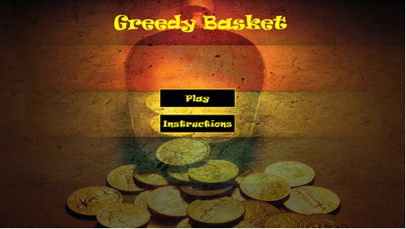
Demo: Using Animations
  Problem Statement:
  Jake has been assigned a task to create a coin catcher game named Greedy Basket for Windows Store. The game allows a user to collect coins in a basket. The user is assigned one score point for every coin collected successfully in the basket.
  Jake has already created the interface of the app, which consists of the following pages:
    Home page: Shows the commands for playing the game and viewing the instructions of playing the game. The interface of the home page is shown in the following figure.
Notes:
12

Slide 13
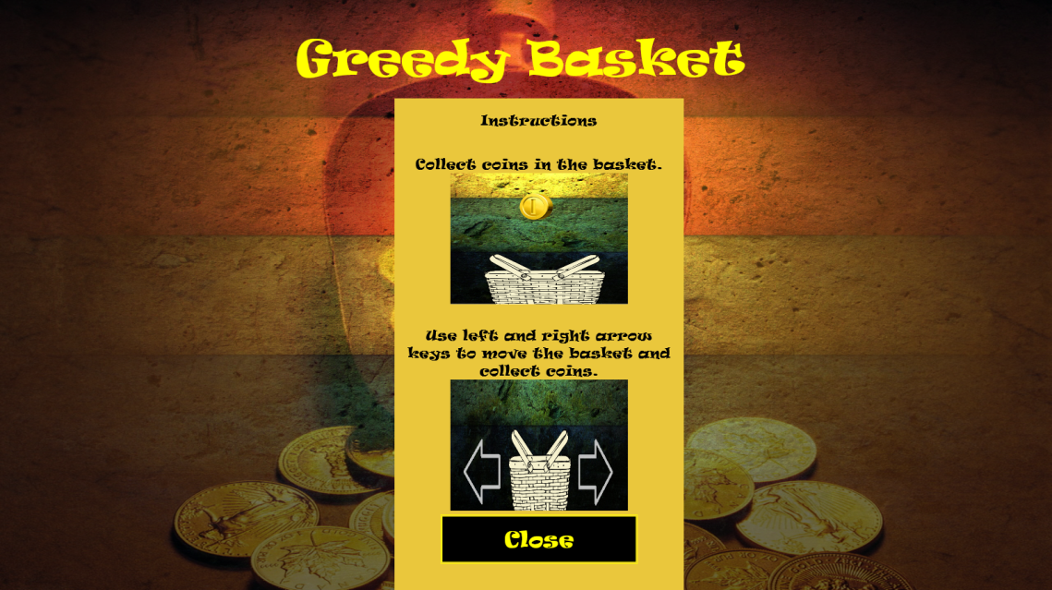
Demo: Using Animations (Contd.)
      Once the user clicks the Play button, the game page is displayed.
      However, when the user clicks the Instructions button, a panel showing the instructions for playing the game is displayed, as shown in the following figure.
Notes:
13

Slide 14

Demo: Using Animations (Contd.)
      Once the user clicks the Close button, the panel displaying the instructions is closed.
    Game page: Shows a basket for collecting the coins, which fall from the top edge of the interface. In addition, this page shows Score, which is the number of coins collected in the basket by the user. The interface of the game page is shown in the following figure.
Notes:
14

Slide 15
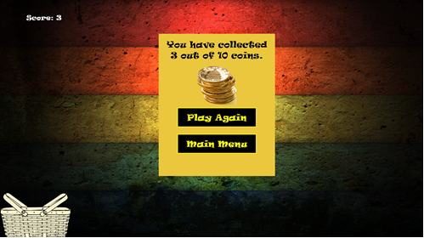
Demo: Using Animations (Contd.)
      The coins can fall from the middle, left, or right end of the screen. The user can move the basket by using the left and right arrow keys on the keyboard.
      After 10 coins have fallen, the game ends, and a panel is displayed. This panel shows the number of coins collected out of 10 and contains the options for playing the game again or going to the main menu, as shown in the following figure.
Notes:
15

Slide 16
Demo: Using Animations (Contd.)
  Now, he needs to implement a set of functionality that makes the coins fall from the middle, left, or right end of the screen randomly. He also needs to implement the functionality to allow users to move the basket on the screen. Further, he needs to implement a logic that calculates the user’s score and displays it to the user when all the 10 coins have fallen. In addition, he wants that there should be a smooth movement of coins and the basket on the screen. Further, there needs to be a smooth transition effect on the panels displaying the instructions and score.
  Help Jake in implementing the desired functionalities in the app.
Notes:
16

Slide 17
Demo: Using Animations (Contd.)
  Solution:
  To implement the required functionality in the app, Jake needs to perform the following tasks:
    1. Implement the game logic.
    2. Add animation to the instruction panel.
    3. Add animation to the coin.
    4. Add animation to the basket.
    5. Add animation to the score panel.
    6. Execute the app and verify the output.
Notes:
17

Slide 18
Summary
  In this session, you learned that:
  Animation Library includes a set of predefined animations that can be added in your app.
  To add an animation, you need to select the required type of animation from a predefined set of animations and add it in your app.
Notes:
18

Slide 19

Q&A

